Slide 1

AMREF INTERNATIONAL UNIVERSITY
SCHOOL OF MEDICAL SCIENCES
DEPARTMENT OF NURSING AND MIDWIFERY SERVICES
BACHELOR OF SCIENCE NURSING
COURSE CODE: BSN 124
COURSE NAME: MEDICAL BACTERIOLOGY AND MYCOLOGY EXAM
DATE: 5- DECEMBER 2023
TIME ALLOWED: 1 MINUTE PER SLIDE
START TIME: 2:00 P.M.

Slide 2
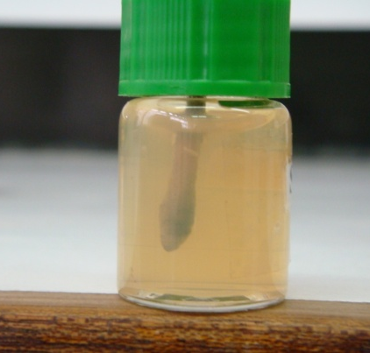
Q. 1 Stuart Transport media used ante-natal clinic for High Vaginal Swabs
Name the disease that would most likely be investigated by a specimen transported in this medium

Slide 3
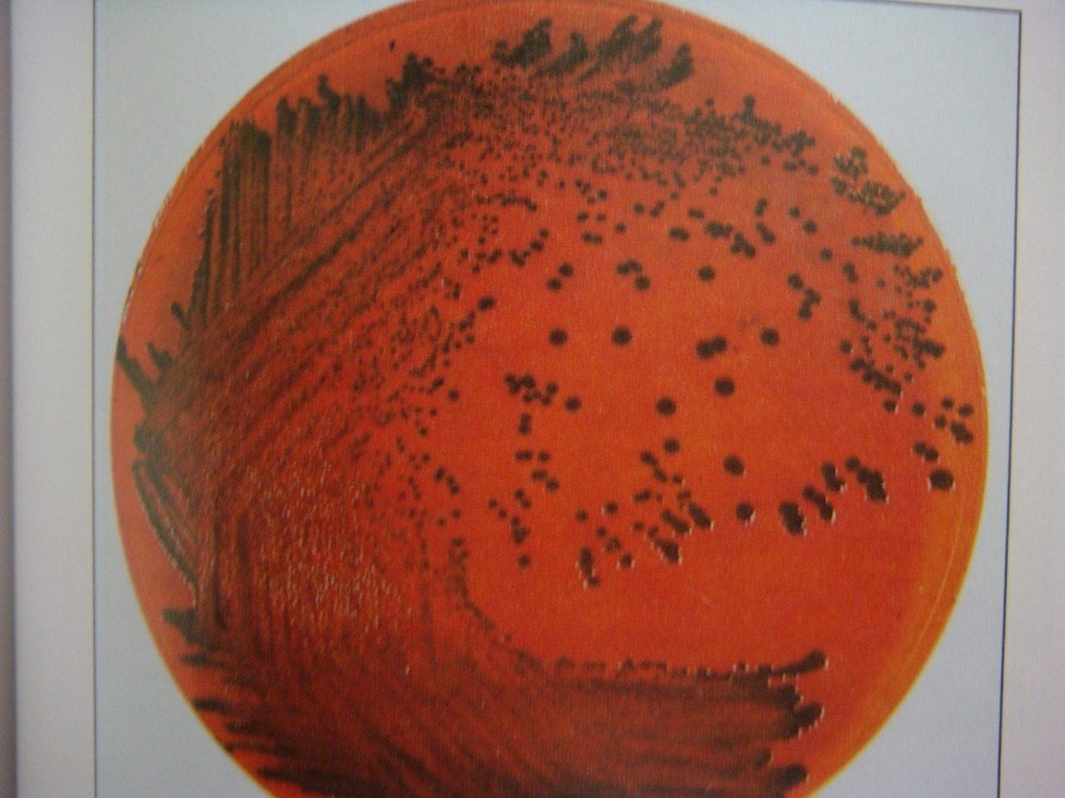
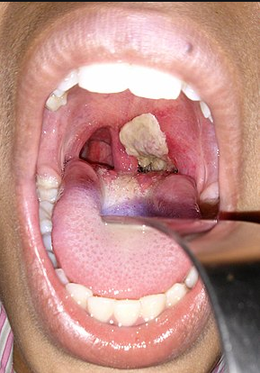
Q. 2 A micrograph of a clinical presentation and PTA culture of a respiratory tract pathogen from a child on a selective medium
PTA
Name the most likely organism

Slide 4
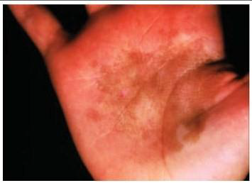
Q.3
Identify the fungal condition

Slide 5
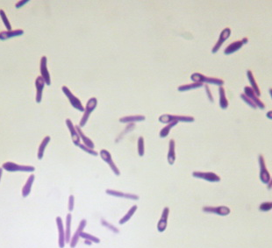
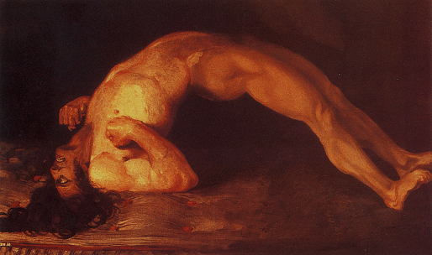
Gram stain of a culture of a wound specimen and clinical manifestation of infection
Q.4
Name the most likely causative agent

Slide 6
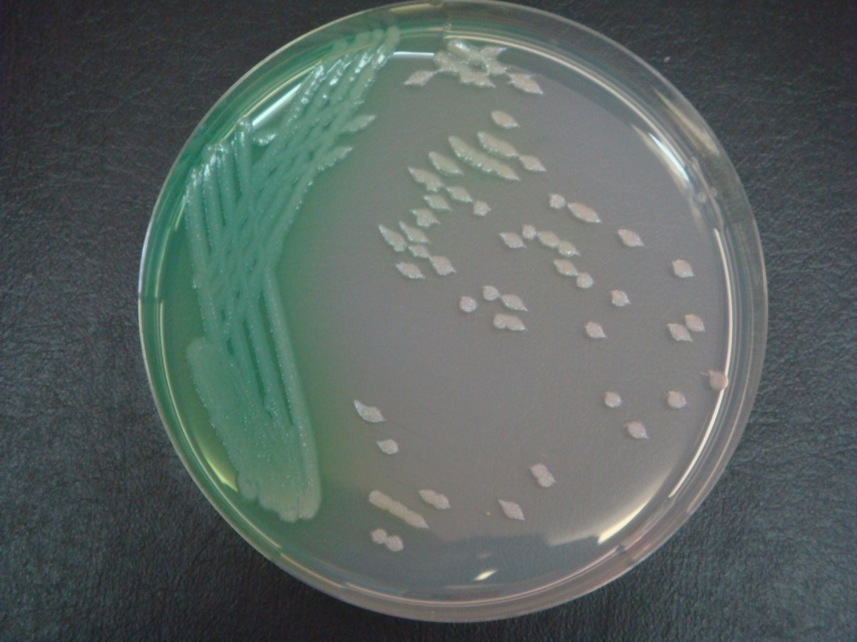
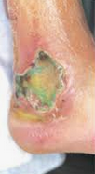
Q. 5 Aerobic culture from a wound infection
Name the most likely organism causing wound infection

Slide 7
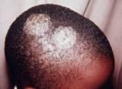
Q.6
Name one likely causative agent of the head lesion

Slide 8
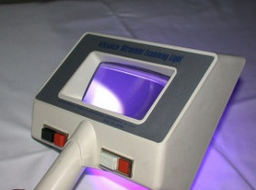
Q.7
Name one fungal agent that the Wood lamp device can aid in the identification in a clinical mycology investigation

Slide 9
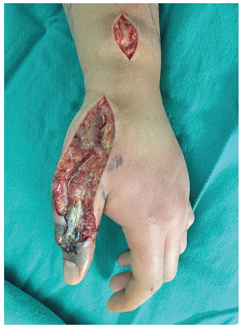
Q.8
Name one bacterial agent that is commonly associated with Necrotizing fasciitis

Slide 10
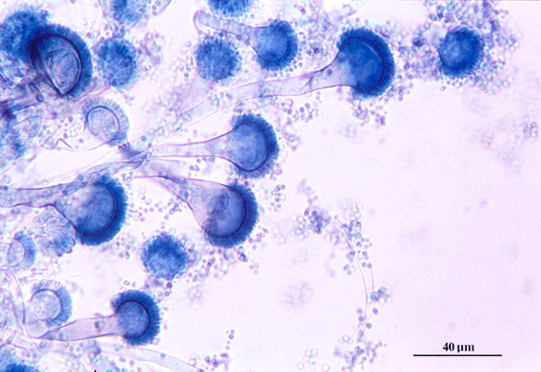
Q. 9
Microscopic examination of stained part of a fungal culture isolated from poorly stored grain.
Identify the genus

Slide 11
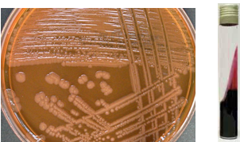
Q. 10
Culture on a MacConkey agar and identification test of a bacterial
pathogen isolated from catheter-associated urinary tract infections.
Identify the most likely pathogen.

Slide 12
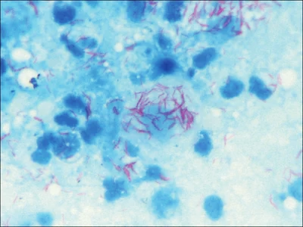
Q. 11
Sputum smear microscopy with Acid Fast bacilli present.
Name the most likely pathogen under investigation

Slide 13
Q. 12
A Gram negative Enterobactericeae isolated from a blood of a food poisoning patient
Name the virulence factor (arrow)

Slide 14
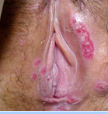
Q. 13 Genital lesions caused by Haemophilus ducreyi.
Name the condition

Slide 15
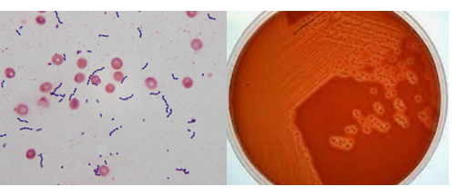
Q.14
Gram stain and culture results of an organism isolated from CSF sample of a newborn
Name the most likely organism under investigation

Slide 16
Skin lesion on the hand of a cow skin trader and Gram stain of isolated sporing Gram-positive bacilli
Name the most likely organsim
Q.15

Slide 17

Q. 16 Quality control item used in a medical microbiology laboratory
Name the process where it is used

Slide 18
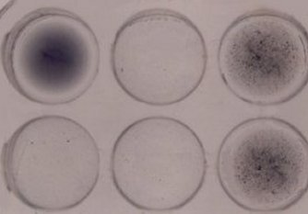
Q. 17 Name the disease under investigation
Rapid Plasma Reagin Serological test set.

Slide 19
Q. 18
Name one bacterial pathogen that can be transmitted through the consumption of unpasteurized milk

Slide 20
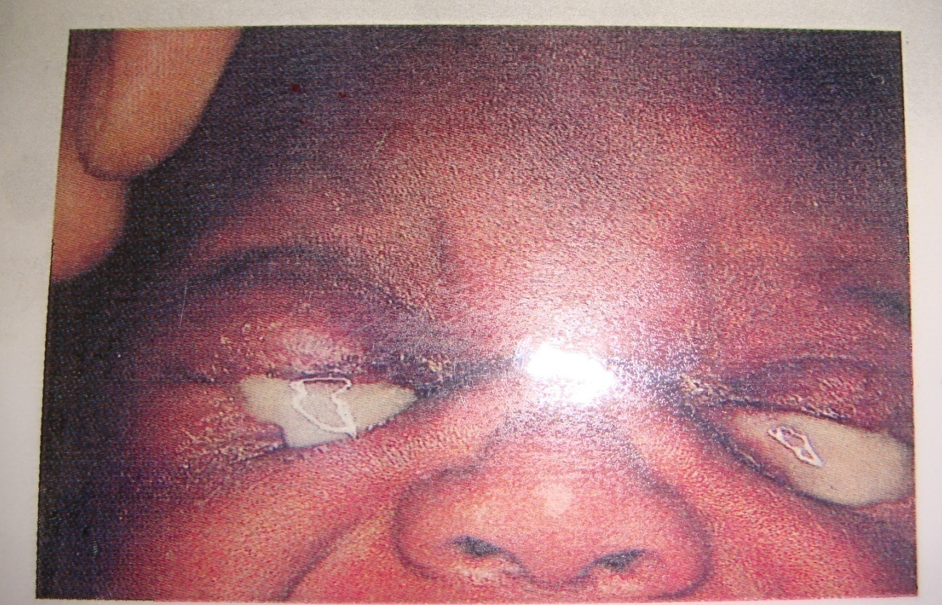
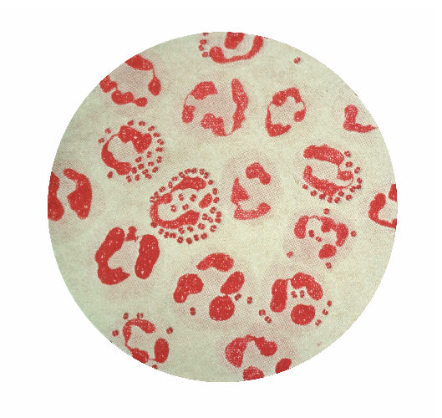
Q. 19 Photograph and Gram stain of an eye discharge from a 5 week old baby.
Name the most likely causative organism

Slide 21
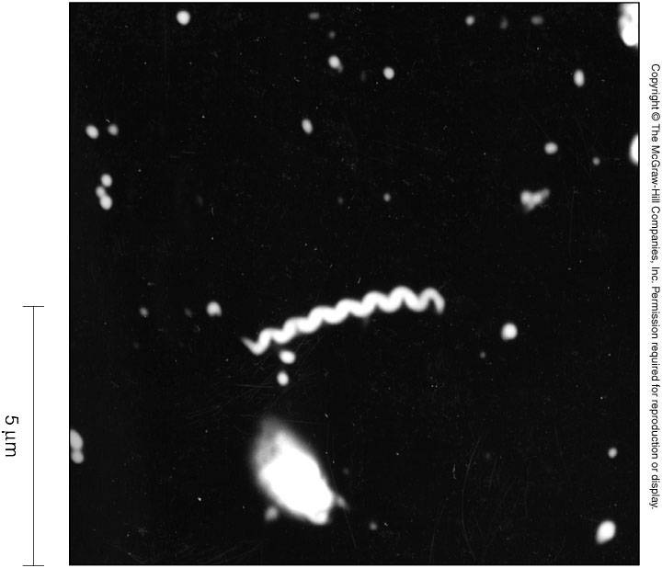
Q. 20
Dark field microscopy of specimen from genital ulcer.
Name the most likely organism

