Slide 1

AMREF INTERNATIONAL UNIVERSITY
SCHOOL OF MEDICAL SCIENCES
DEPT. OF NURSING AND MIDWIFERY SERVICES
BACHELOR OF SCIENCE MIDWIFERY: BSM 211
PRACTICAL SPOT EXAM

Slide 2
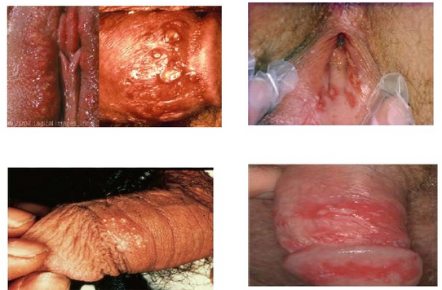
Q1. Clinical presentation in genital viral infection
a. Identify the most likely causative agent
b. Mention the antiviral agent of choice

Slide 3
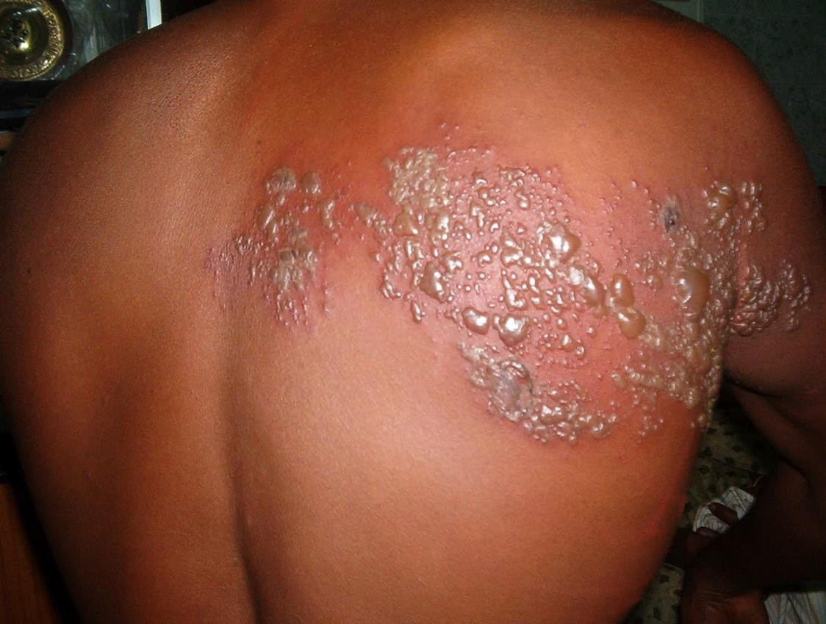
Q2.
a. Identify the most likely causative agent
b. Mention the antiviral agent of choice

Slide 4
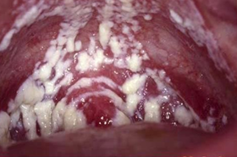
Q3. Oral manifestation in HIV infection
What is the clinical condition presented?
Mention a likely causative agent

Slide 5
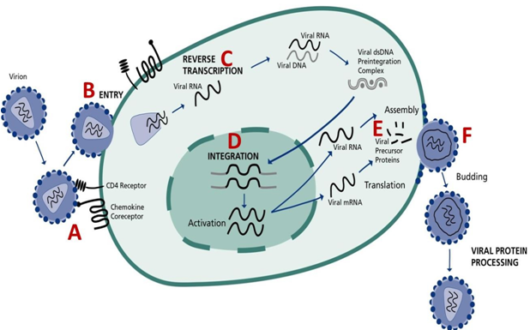
Q4. HIV Replication cycle
Mention 2 drugs that act on ‘C’
a.
b.

Slide 6
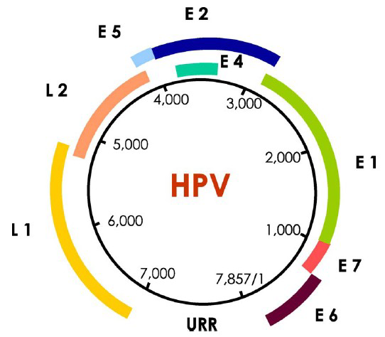
Q5. Double stranded Human Papillomavirus genome
a.
b.

Slide 7
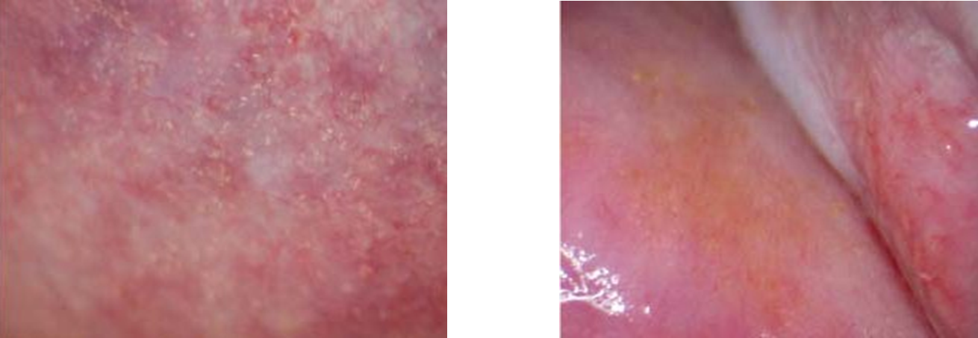
An infection resulting in cervical lesions as seen below:
Q. 6
Name the parasite causing this infection
Which drug is recommended for treatment of this infection?

Slide 8
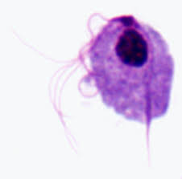
This parasite was observed from a wet mount vaginal secretion
Q. 7
Name the parasite
What drug is recommended for treatment

Slide 9
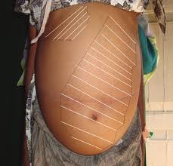
Name one parasite that may cause the condition marked in this picture:
Q. 8
What is this condition
Name one parasitic infection likely to result in this condition

Slide 10
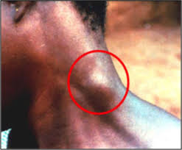
Presentation following a parasitic infection is circled in this image
Q. 9
Name the condition marked by the circle
How is this infection transmitted

Slide 11
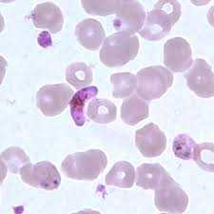
Microscopic examination of a thin Giemsa-stained blood smear from a febrile patient reveals the following:
Q. 10
What is your diagnosis?
How could this infection have been acquired?

Slide 12
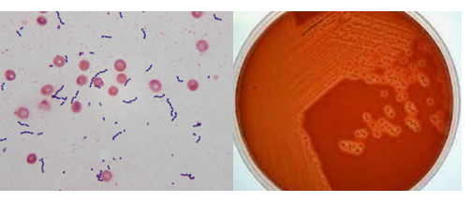
Q. 11
Gram stain and culture results of an organism isolated from CSF sample of a newborn
Identify the Gram staining reaction on the bacteria
Name the most likely bacterial pathogen under investigation

Slide 13
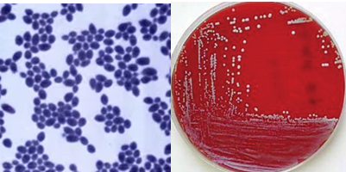
Q. 12
Gram stain and culture results of an organism isolated from urine sample of a pregnant mother attending antenatal clinic. Patient presented with vaginal soreness and discharge with cottage-cheese appearance
Name the most likely organism under investigation
Mention an agent for treatment

Slide 14

Q. 13
A Quality control item used in infection control procedures.
Name the process where it is used
Identify the item

Slide 15
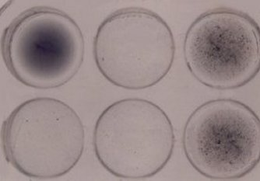
Q. 14
A screening test used in an ante-natal clinic
Name the disease under investigation
Name the causative agent
Rapid Plasma Reagin Serological test set.

Slide 16
Q. 15
Mention 2 Clinical manifestations of gonorrhoea in women
a.
b.

Slide 17
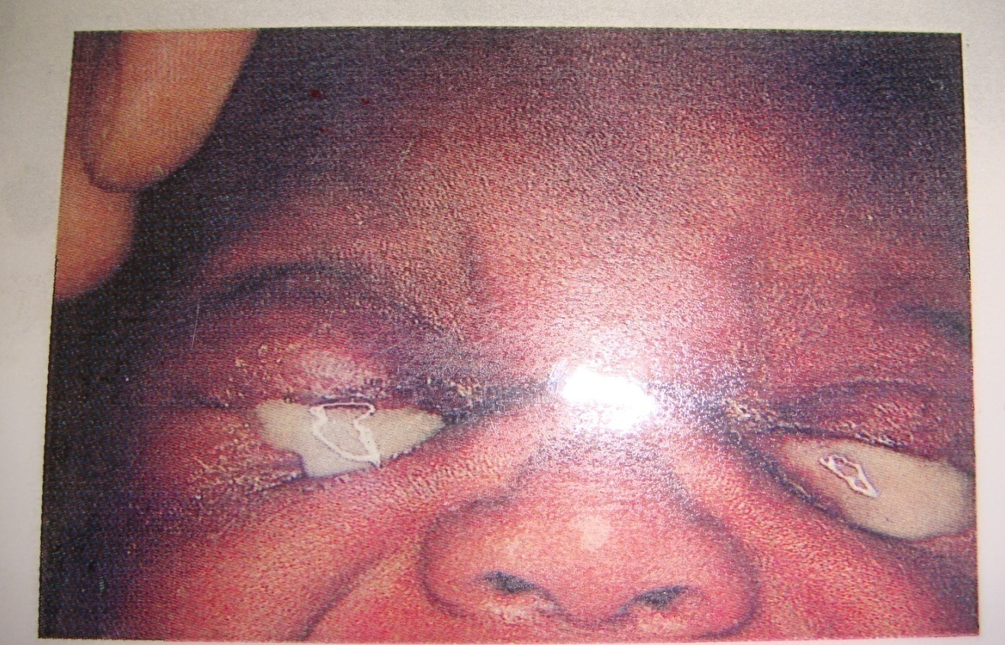
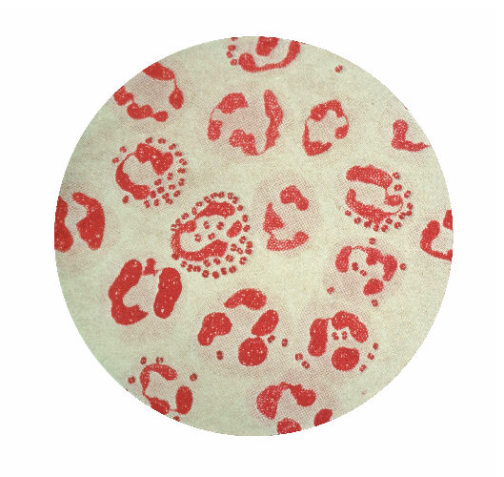
Q. 16
Photograph and Gram stain of an eye discharge from a 5-week-old baby.
a. Name the most likely causative organism
b. Mention one agent used at birth to prevent the progression of infection.

Slide 18
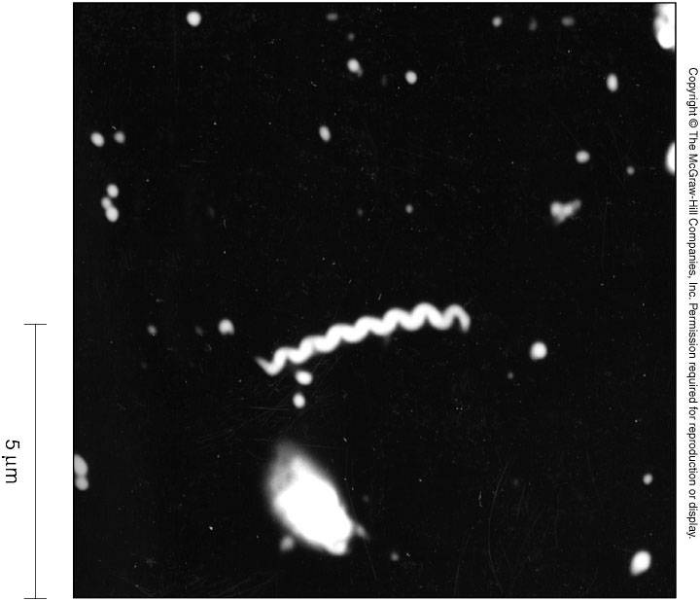
Q. 17
Dark field microscopy of specimen from genital ulcer 10 days
after unprotected sexual intercourse
Name the most likely bacterial agent seen
Name the associated disease

Slide 19
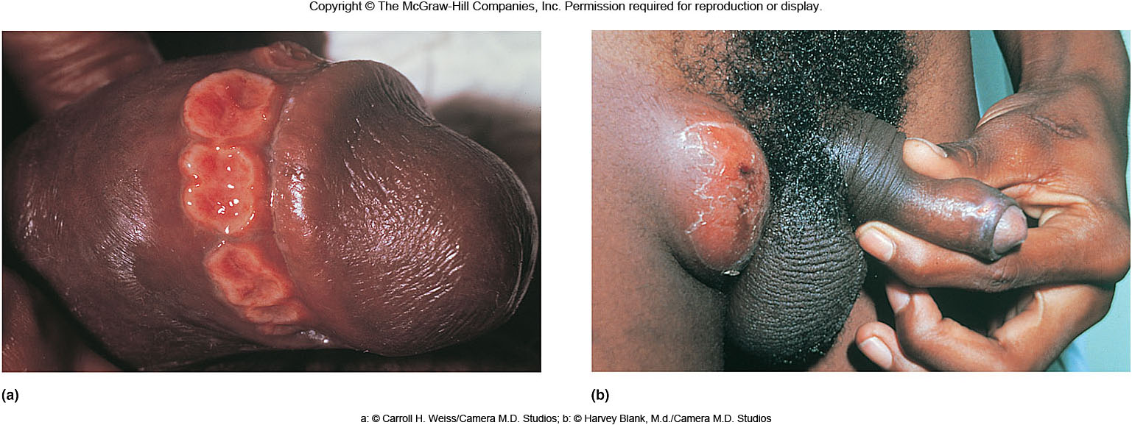
Q. 18 Genital ulcer disease
Mention two bacterial causative agents
a.
b.

Slide 20
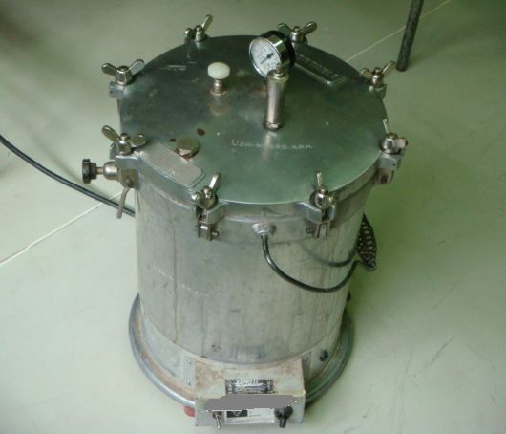
Q. 19
Identify the equipment above
Mention two items processed using the equipment

Slide 21
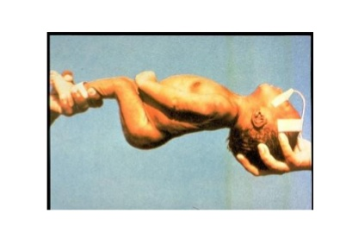
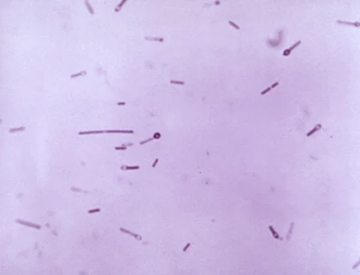
Q. 20
Neonate presenting a few days after home delivery with severe muscle rigidity and infected umbilical cord stump; and gram stain picture of bacterial pathogen isolated from the infected wound
Name the most likely causative agent of the condition
Mention one preventive measure

